Slide 1
AI-ML(Python) Project
Name-Himani
Roll. No.- 2210990401
Group-G-30
Project Name-Text to speech
:
Chitkara University Institute of Engineering and Technology,
Chitkara University, Punjab

Slide 2
Table of Contents
Introduction
Problem statement
Key Features
Result
Conclusion

Slide 3
Introduction
In today's digital age, the ability to convert text into speech is increasingly valuable, with applications ranging from accessibility tools to enhancing user experiences in various domains such as customer service, education, and entertainment. Python, with its simplicity and extensive libraries, offers a robust platform for developing such applications.
This project aims to demonstrate the power and versatility of Python in creating a text-to-speech (TTS) application. Using the Text-to-Speech (TTS) technology, I have built a Python program capable of converting written text into spoken words, enabling users to listen to the content instead of reading it

Slide 4
Problem statement
Overview: In today's digital landscape, access to information is crucial for everyone, including individuals with visual impairments or those who prefer auditory learning. Text-to-speech (TTS) technology plays a vital role in converting written text into spoken words, thereby enabling better accessibility and user experience across various platforms and applications.
Challenges:
Despite the advancements in TTS technology, several challenges persist, including:
Naturalness and Intelligibility: Ensuring that the synthesized speech sounds natural and intelligible, mimicking human speech patterns, intonation, and emphasis.
Real-Time Processing: Achieving real-time processing capabilities to minimize latency and deliver seamless text-to-speech conversion in interactive applications.
Customization and Personalization: Allowing users to customize the speech output according to their preferences, including voice selection, speech rate, and pitch adjustments.

Slide 5
Key Features
Customizable Speech Speed:
Users can adjust the speed of the synthesized speech output according to their preferences, enabling faster or slower playback as desired.
Gender Selection:
The application offers the flexibility to choose between different genders for the synthesized speech, providing options such as male, female, or neutral voices to suit individual preferences.
Save Feature:
Users have the ability to save the synthesized speech output as audio files in various formats (e.g., MP3, WAV), allowing them to listen to it offline or share it with others.
Text Input Support:
The application accepts text input from various sources, including typed text, copied text from other applications, or imported text files, providing seamless integration with existing workflows.
User-friendly Interface:
The user interface is intuitive and easy to navigate, with straightforward controls for adjusting speech speed, selecting gender, and saving audio files, ensuring a smooth user experience.

Slide 6
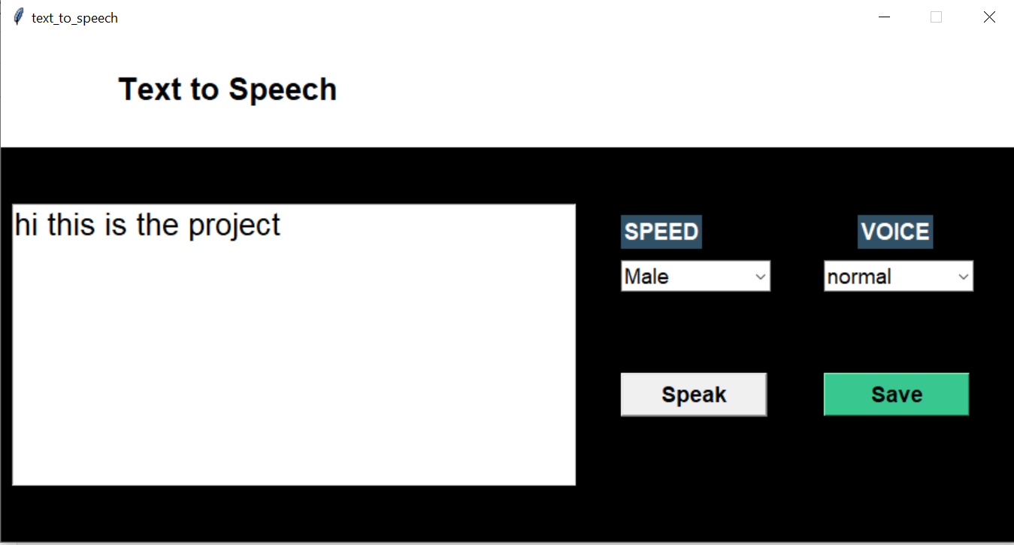
Results

Slide 7
Conclusion
In conclusion, our text-to-speech project represents a significant advancement in accessibility and user experience. By providing a feature-rich application with customizable speech options, multilingual support, and seamless integration, we've created a tool that empowers users to engage with digital content more effectively. As we look to the future, we remain committed to further enhancing our solution and exploring new opportunities to innovate in the field of text-to-speech technology.

Slide 8


